Slide 1
AppSec Demo
RCE via legacy dependency in Python

Slide 2

Reduce cybersecurity risk in Equinor’s SDLC
https://appsec.equinor.com
Notes:
We are an enabling team, meaning we don’t work directly on software products, but we support DevOps teams
We typically:
- Procure and manage Application Security tools for DevOps teams
We organize workshops, establish guidelines, contribute to governance
Maintain a network of Security Champion and cater for the AppSec community in Equinor
The team was born February 1 2022 and we currently have 9 people across 3 Bergen, Stavanger, Trondheim (as of June 2024)

Slide 3
Example Problem
CONTEXT
Reservoir simulation software that is configured using yaml files
The simulator is tested and reliable, but old and hard to maintain
Data is restricted, all the processing must happen in a confined environment
REQUIREMENTS
Build a simple tool to check that yaml configurations are valid
Validation performed via a library that comes with the simulator
Only Python v3.4 is available in the confined environment

Slide 4
DEMO #1 How hard can it be?
Notes:
Developer perspective - follow the instructions in the repo!

Slide 5
Awesome!
That was easy, time to

Slide 6

Awesome!
That was easy, time to
Deploy
Host a demo for my colleagues

Slide 7

Awesome!
That was easy, time to
Deploy
Host a demo for my colleagues
Add an Achievement to my People@Equinor
Take a selfie and post it on LinkedIn

Slide 8
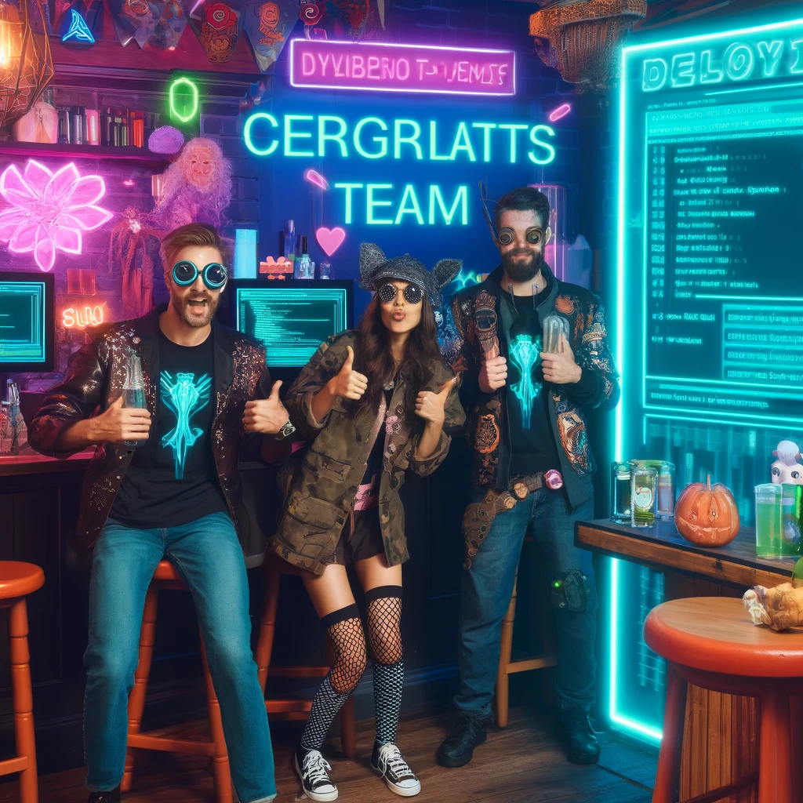
Awesome!
That was easy, time to
Deploy
Host a demo for my colleagues
Add an Achievement to my People@Equinor
Take a selfie and post it on LinkedIn
Go out and celebrate!

Slide 9
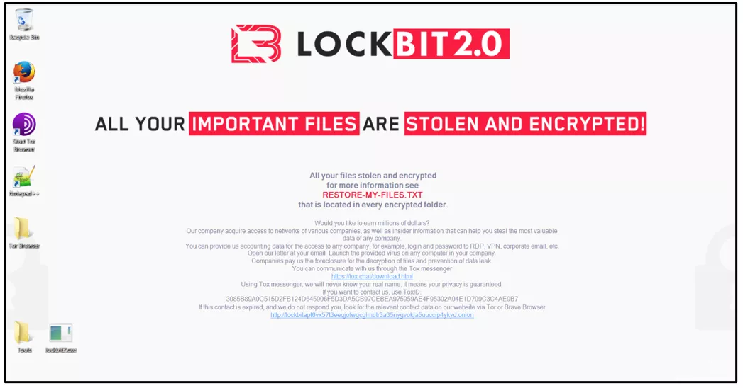

Slide 10
DEMO #2 WTF?!
Notes:
Attacker perspective - follow the instructions in the repo!

Slide 11
DEMO #3 Let’s take some precautions
Notes:
Hardening perspective - follow the instructions in the repo!

Slide 12
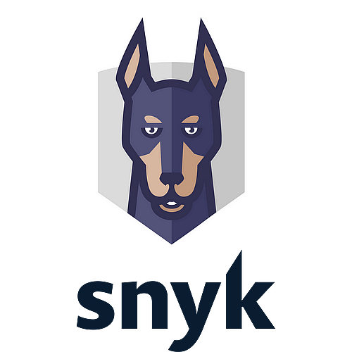
Key Takeaways
When you write your own code …
Use Snyk Code in your IDE
When you use 3rd party libraries …
Use Snyk Open Source for checking your dependencies
Configure Snyk for monitoring your deployments
Establish routines for regularly updating libraries

Slide 13
We are responsible for the code we write!
Notes:
No matter what (AI) tool we use, we are responsible for the code we write!
One last thing: how did the attacker figured out they could mess with my application?

Slide 14
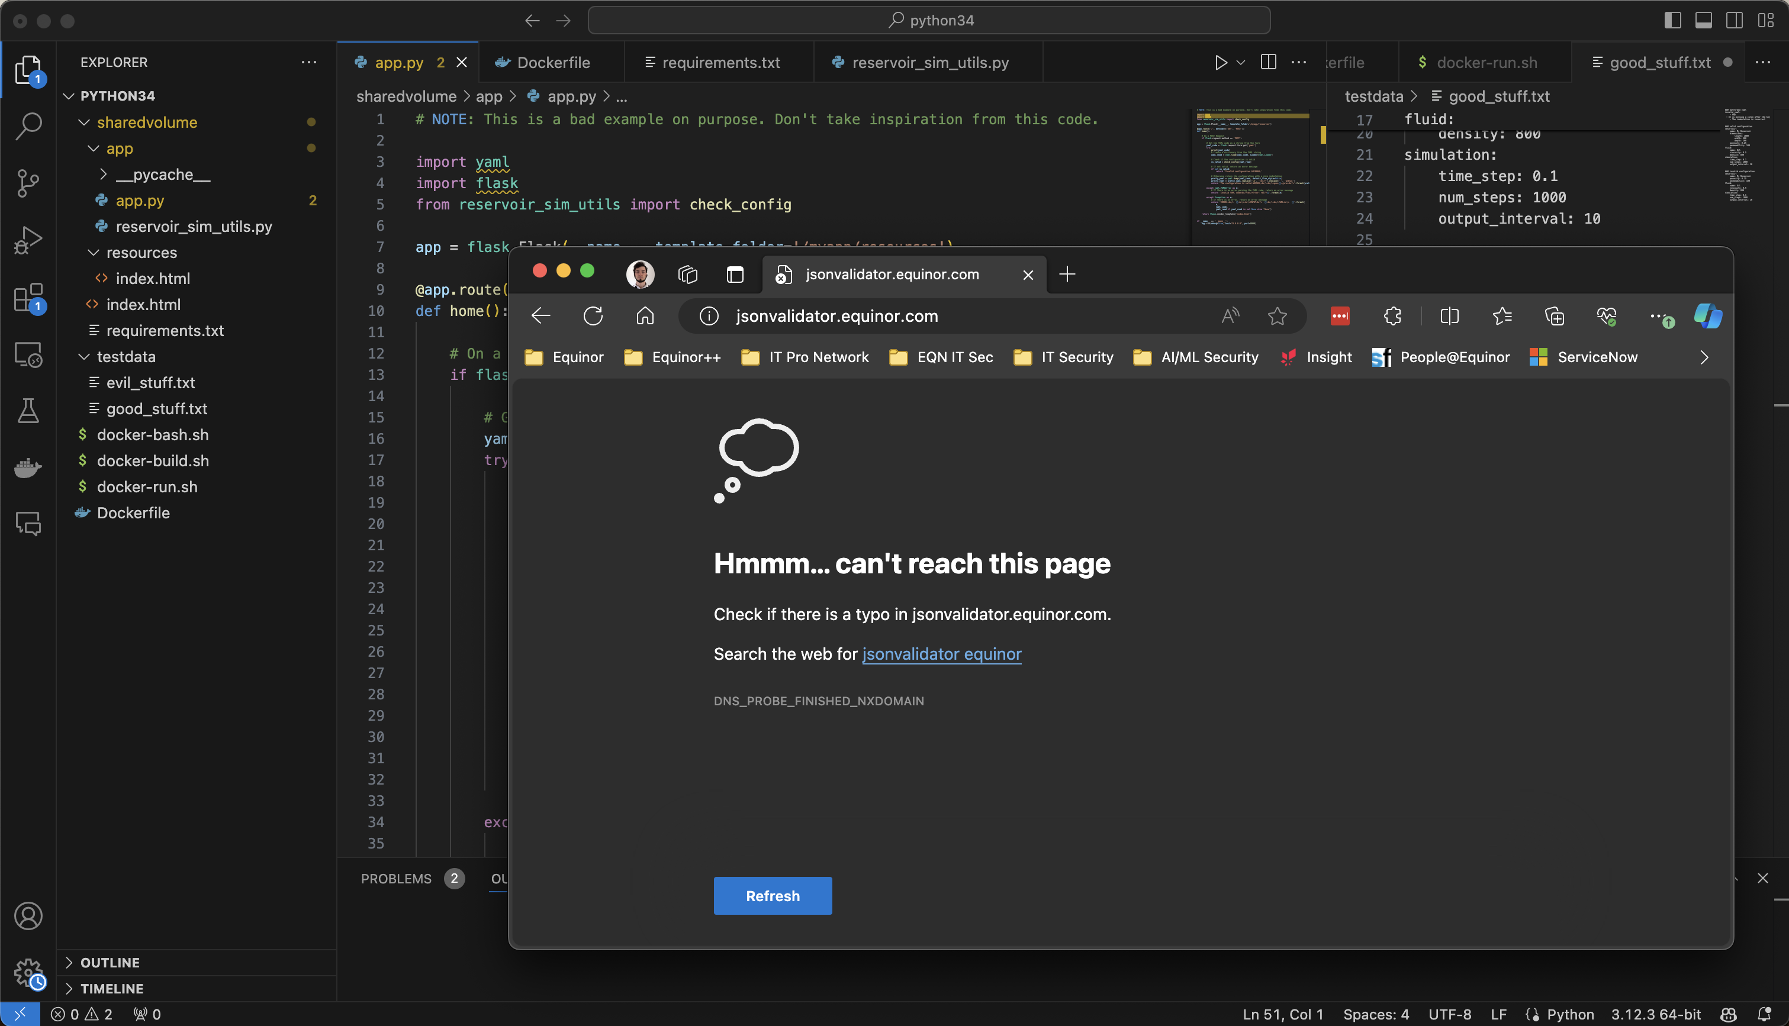



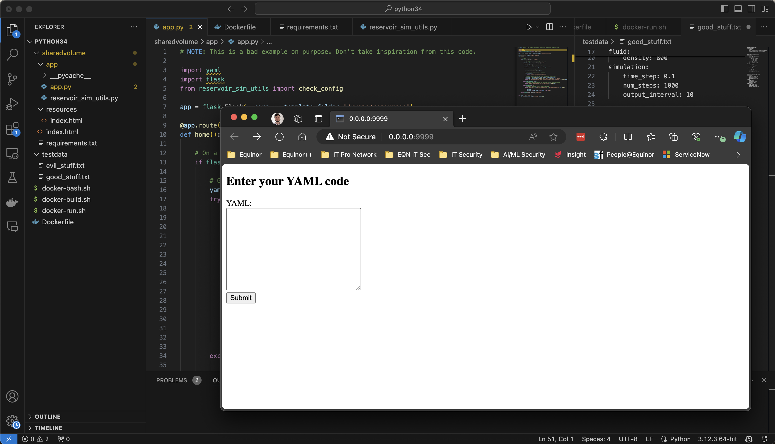
Notes:
This is the screenshot I posted on linkedin. Notice anything special?

Slide 15
Notes:
The vulnerable library is there

Slide 16
Notes:
The address of my web application is there
BE MINDFUL WHEN POSTING ON SOCIAL NETWORKS
NOTE (ignore this during the presentation)
The premise here is that this is supposed to run in an isolated environment, so it’s unlikely it would be exposed to the outside world
On the other hand, insiders are a serious risk, so the concern is valid. But all of this discussion is too much for the context of the presentation

Slide 17
AppSec Demo
RCE via legacy dependency in Python
https://appsec.equinor.com

